Slide 1
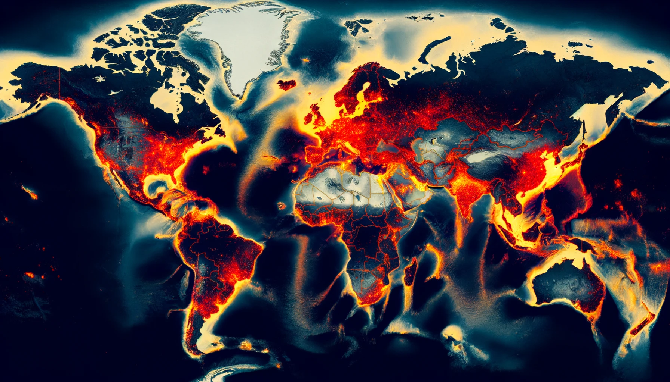
TERRORISM DASHBOARD

Slide 2





Meet Our Team
OPTIMUS
Namratha Alapati Scrum Master
Akash Reddy Tummala Product Owner
Sanisha Kolanu Developer
Priyadarshini Devarapalli Developer
Ninad Bhavesh Daftary
Developer

Slide 3
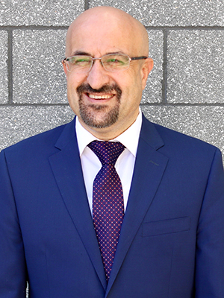
Project Partner
Dr. Mahmut Cengiz
Associate Research Professor
Expertise: Terrorism, Organized Crime, Illicit Economies
Field Experience: Middle East, Asia, Europe
Publications:
"Terrorism Networks: Understanding the Threat"
"Global Smuggling: A Comprehensive Analysis"
"Illicit Economies: Impact on Global Security"
Focus: Understanding and combating global challenges in terrorism and criminal activities

Slide 4

Problem Statement
This project seeks to address key research questions and create a dashboard offering actionable insights into terrorism trends. Leveraging the Global Terrorism Trends And Analysis Center (GTTAC) dataset, the study aims to analyze:
Incident frequency by region
Operational capacities of groups
Evolution of terrorist methods (2018-2023)
Characteristics of Iran-backed versus jihadist groups
Influence of tactics and ideologies on lone actors
Correlation between perpetrators and attack methods
Factors affecting attack severity
Impact of weapon and target selection on tactics
This Photo by Unknown author is licensed under CC BY-SA-NC.

Slide 5
DataSets
GRID Incidents Datase
This dataset catalogs each terrorist incident with specific details on the event, perpetrator, and location to analyze patterns and trends in terrorism.
Varies from 2018 -2023
CSV format
Open Source
GRID Perpetrators Dataset
This database has profiles of terrorist organizations and individuals, including their characteristics and involvement in terrorist acts, to understand perpetrator dynamics.
Varies from 2018 -2023
CSV format
Open Source
GRID Source Dataset
This database aggregates the information of diverse sources to ensure the accuracy and reliability of the data on terrorist incidents.
Varies from 2018 -2023
CSV format
Open Source

Slide 6
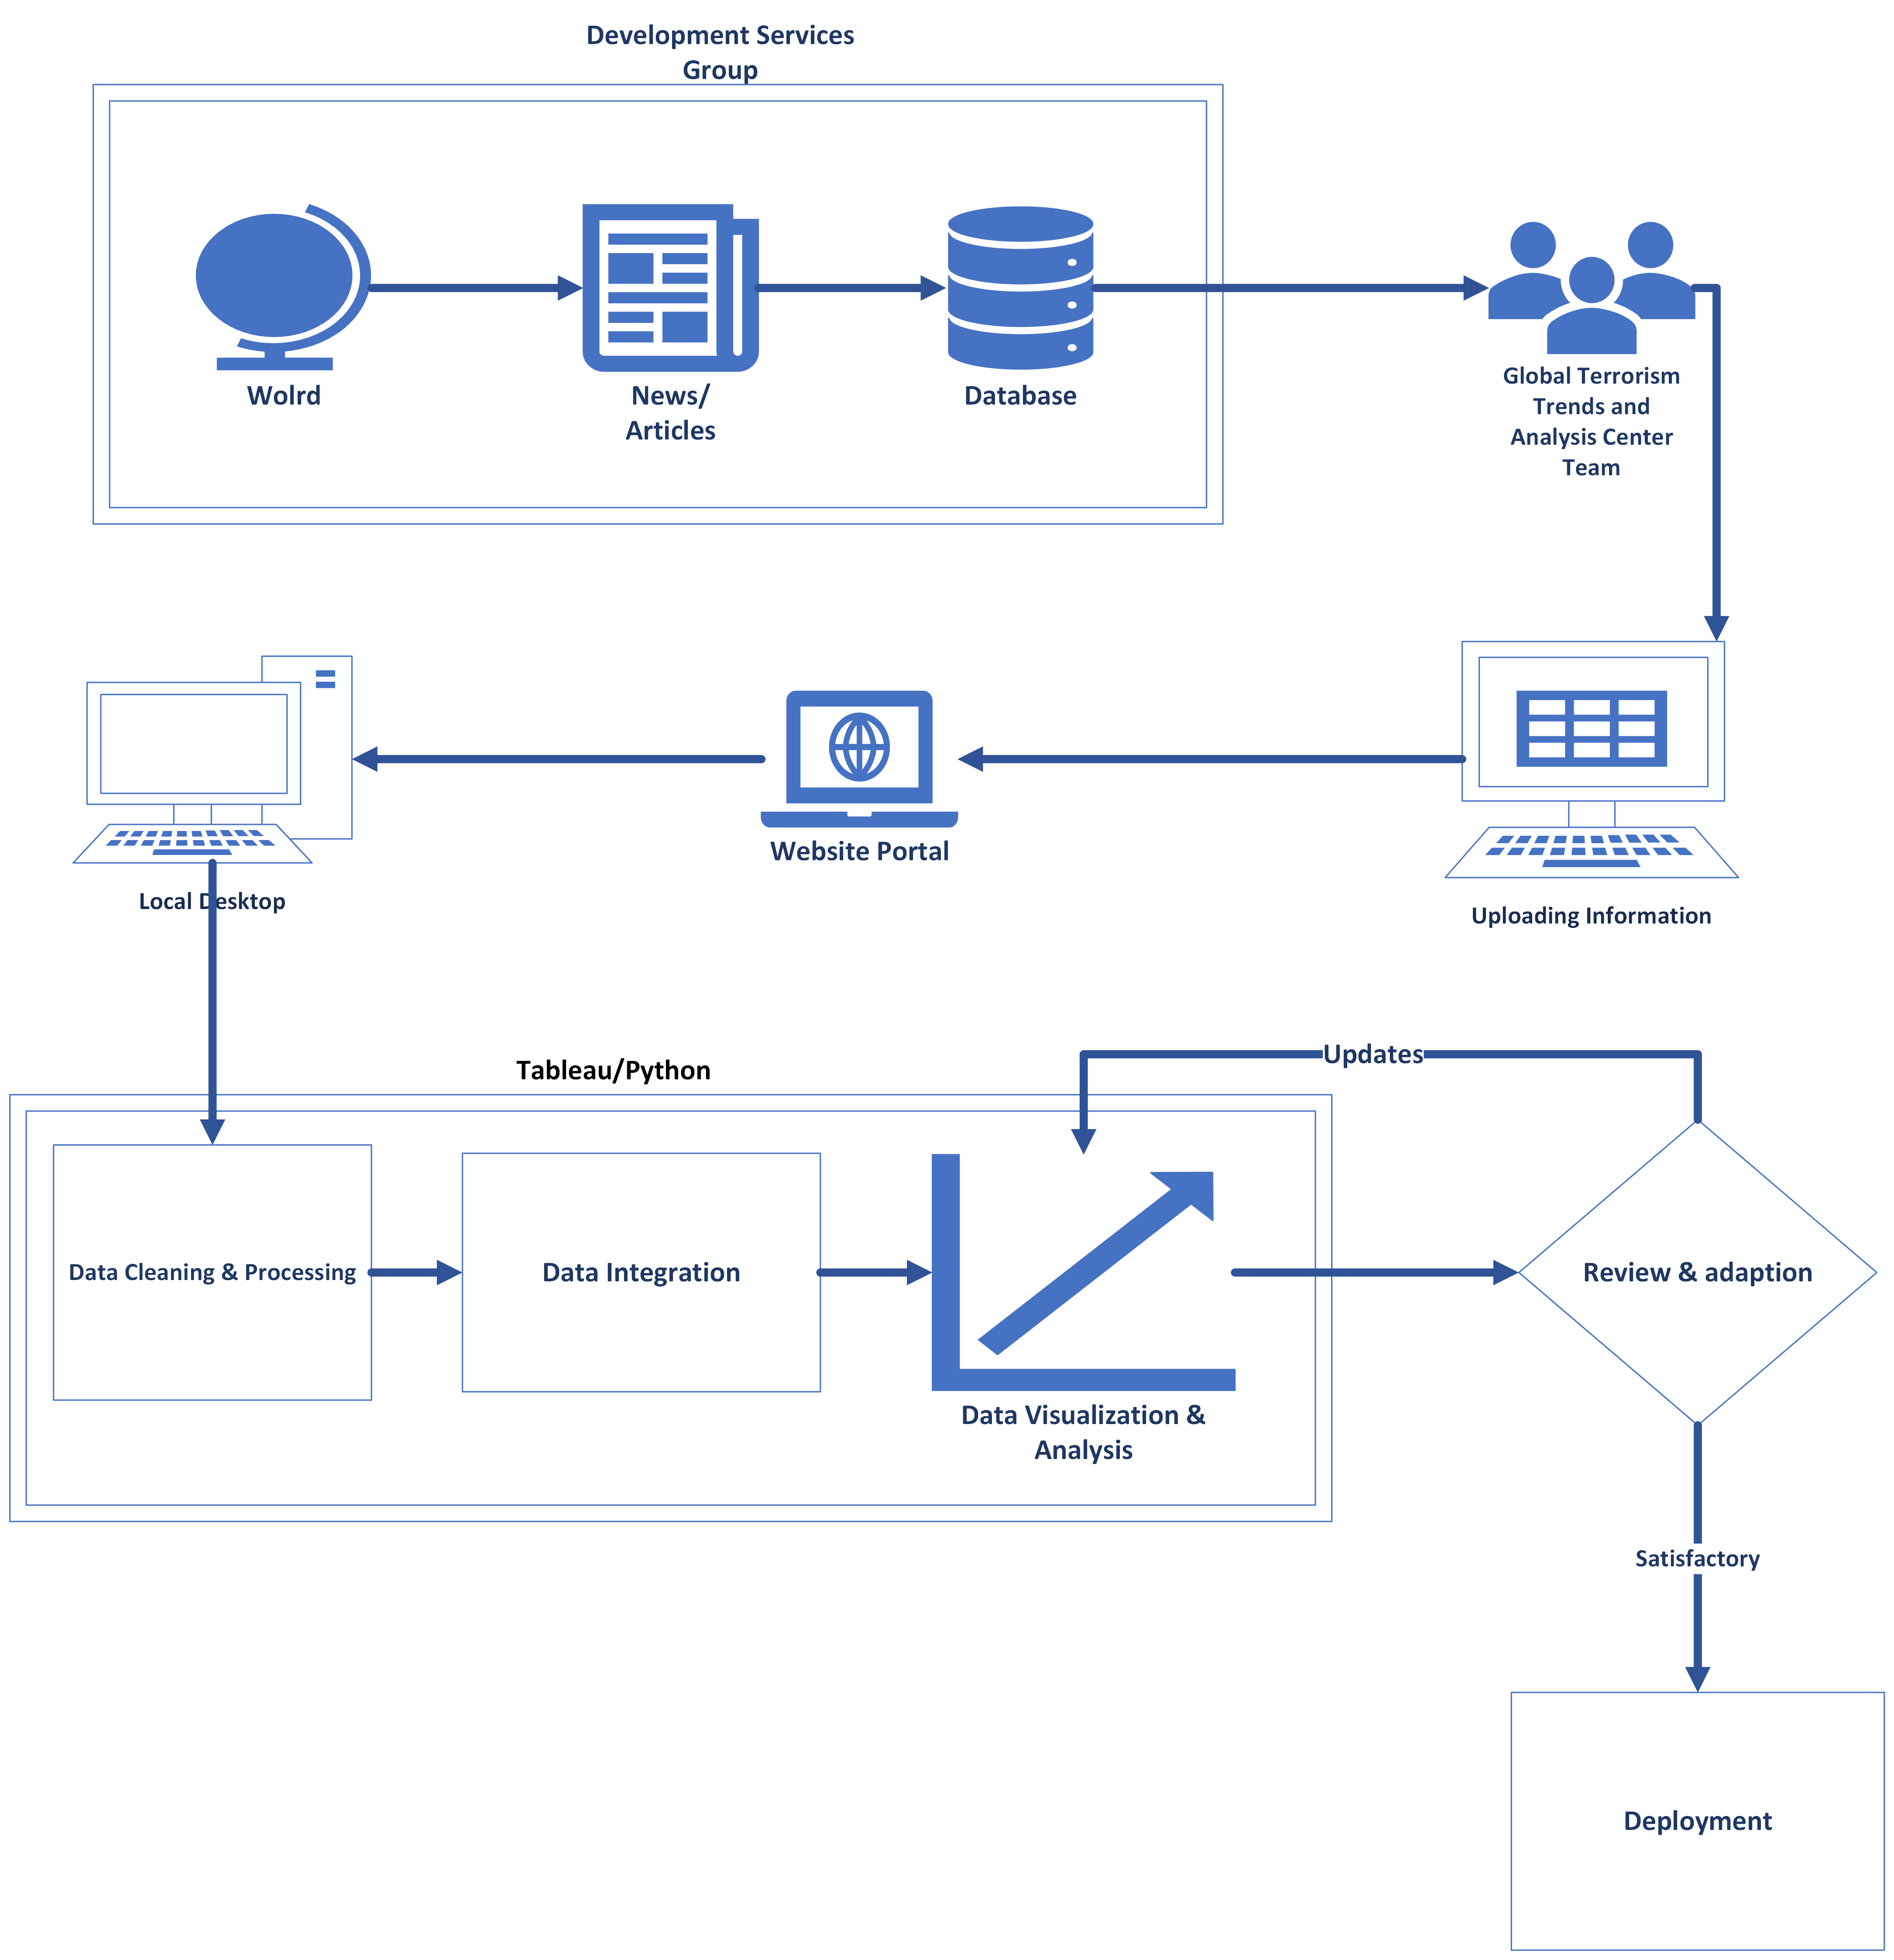
Data Flow

Slide 7
Visualizations

Slide 8
Research Question 1
What regions/countries record the most terrorist incidents?

Slide 9
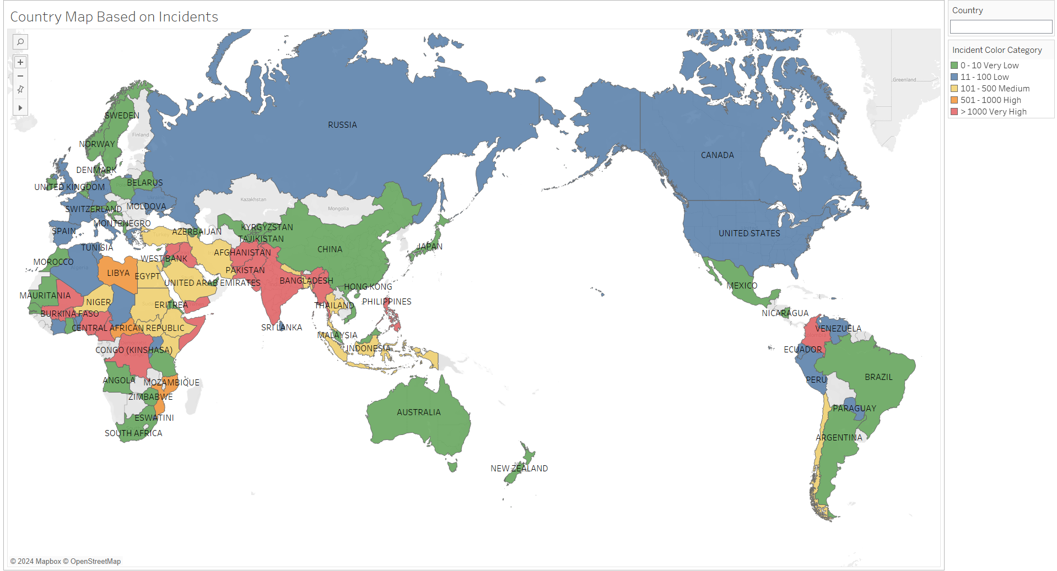

Slide 10
Research Question 2
What terrorist perpetrator types have the most operational capacity regarding tactic, weapon, and victim types?

Slide 11
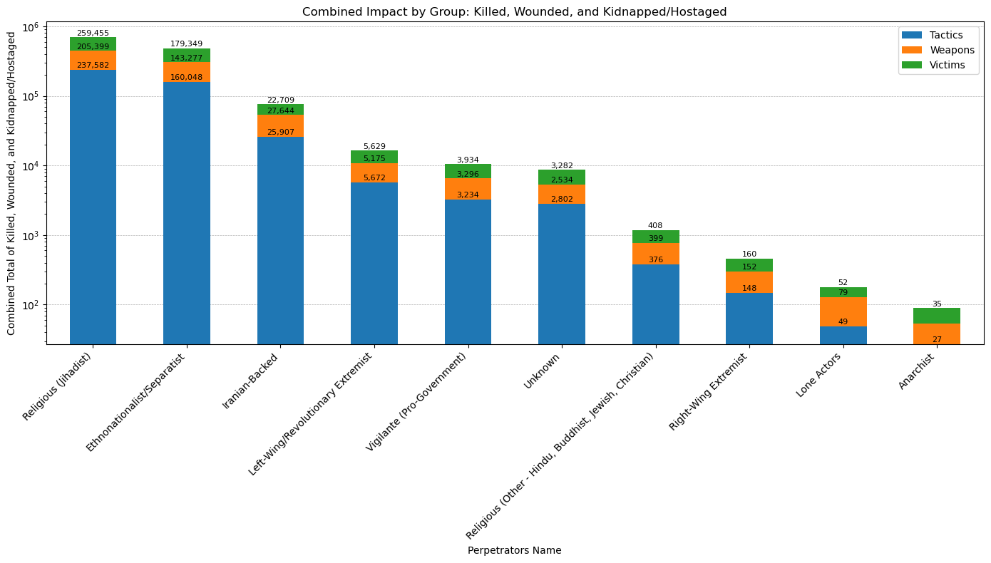

Slide 12
Research Question 3
How have terrorist tactics, targets, weapons, facilities, logistics, and victim types changed from 2018 to 2023?

Slide 13
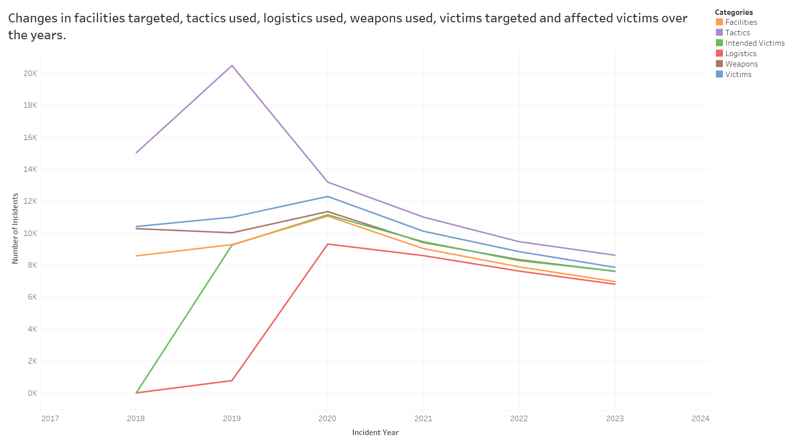

Slide 14
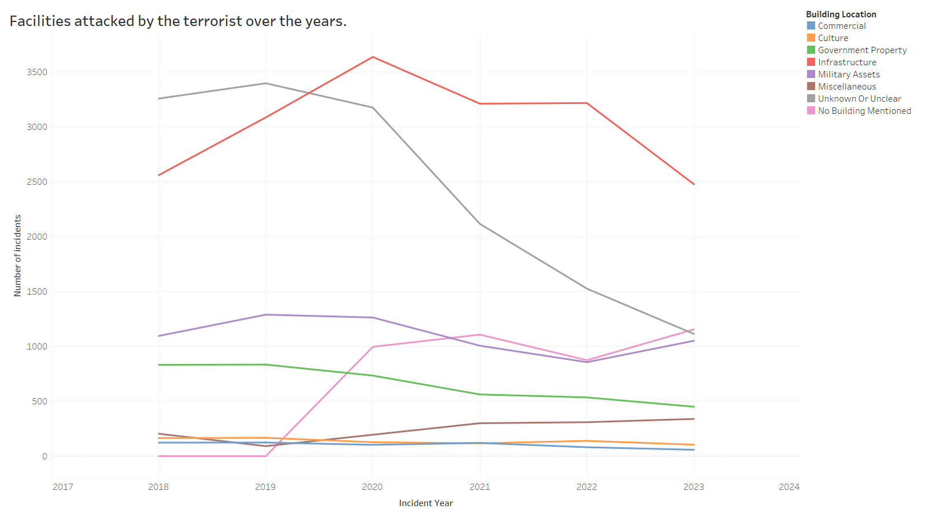

Slide 15
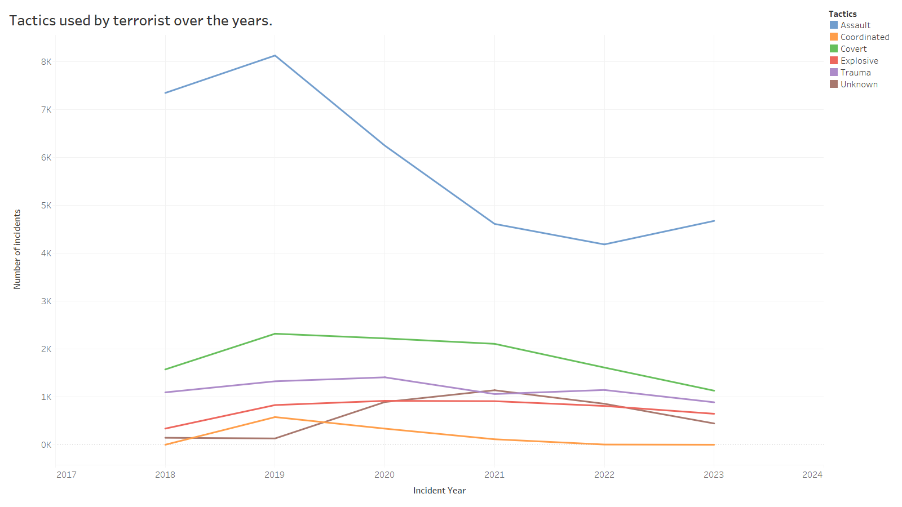

Slide 16
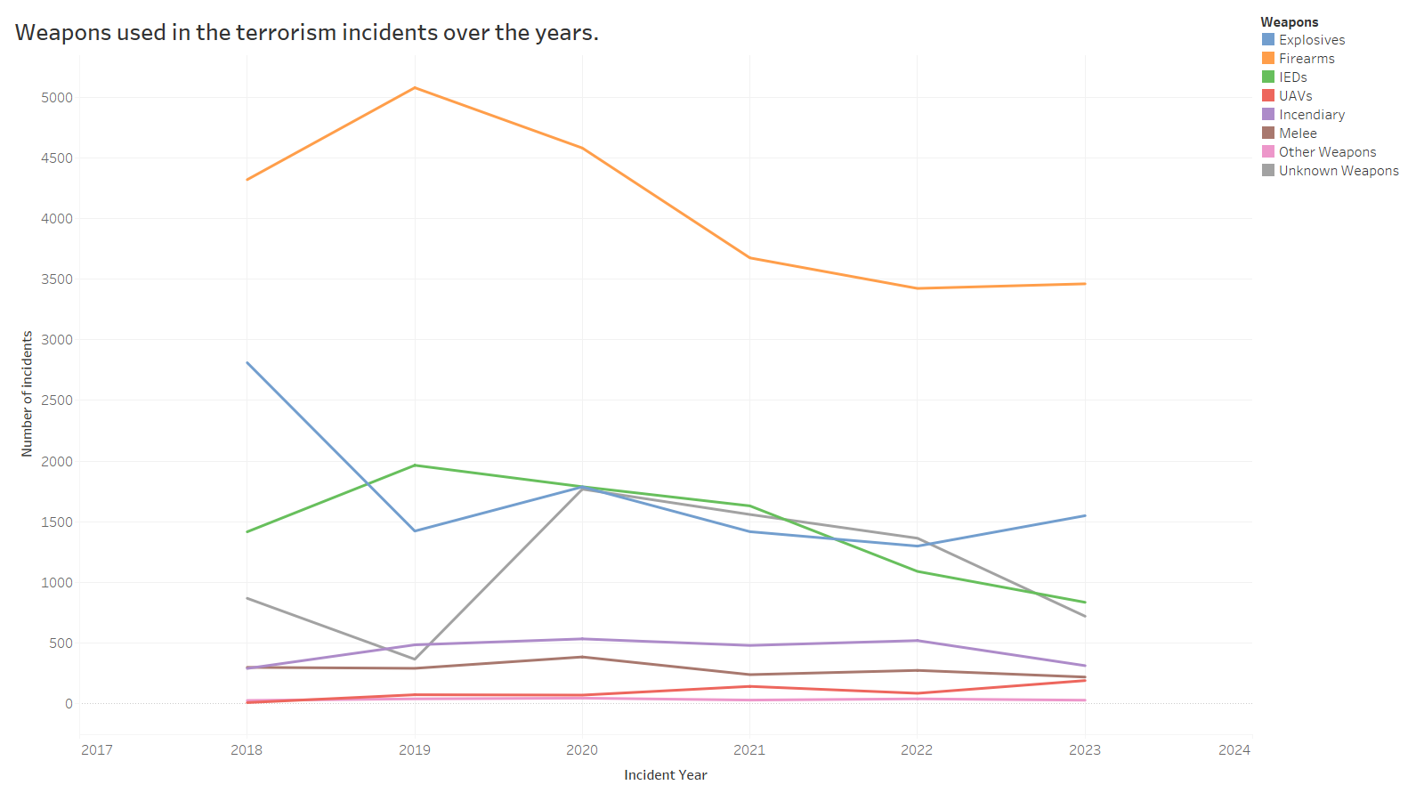

Slide 17
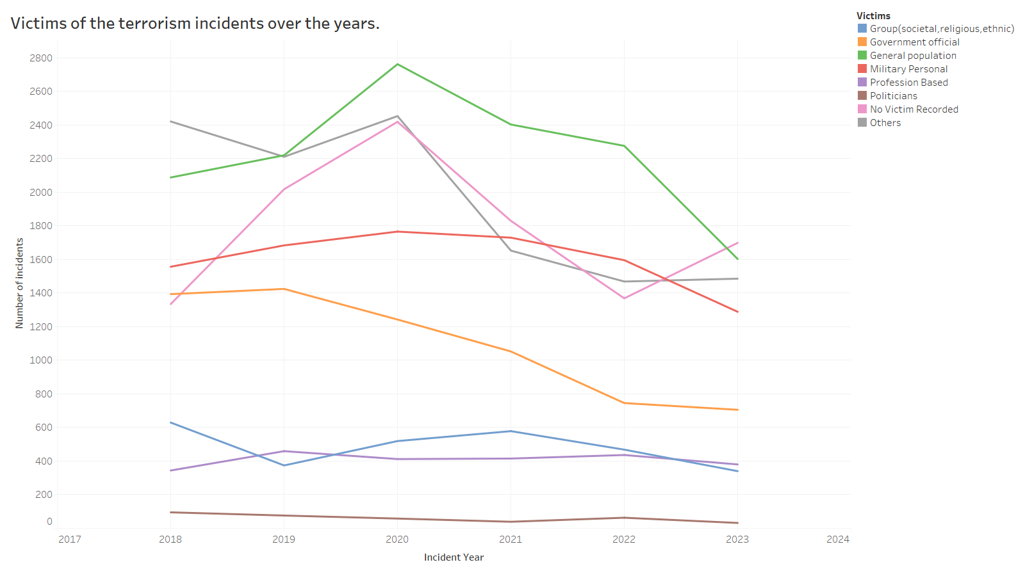

Slide 18
Research Question 4
What are the similarities and distinctions between Iran-backed and Jihadist terrorist groups?

Slide 19
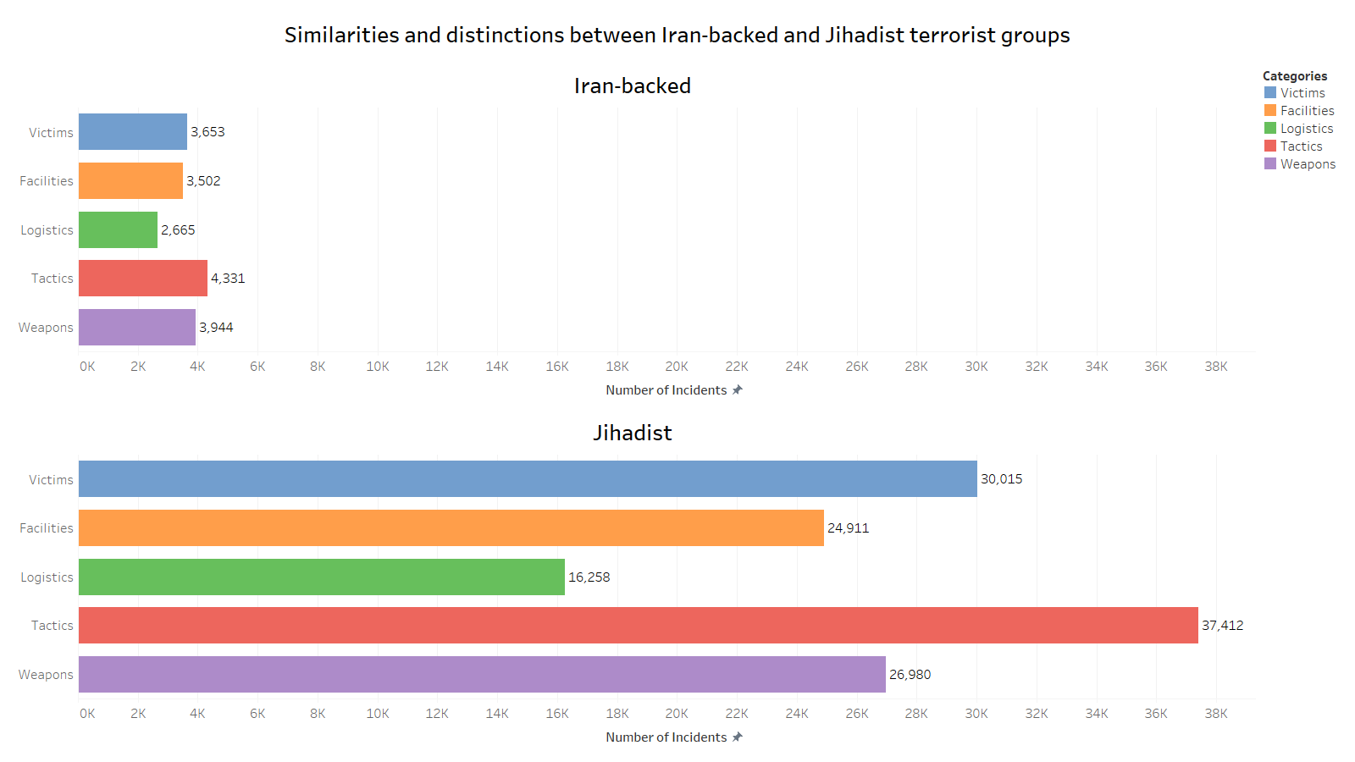

Slide 20
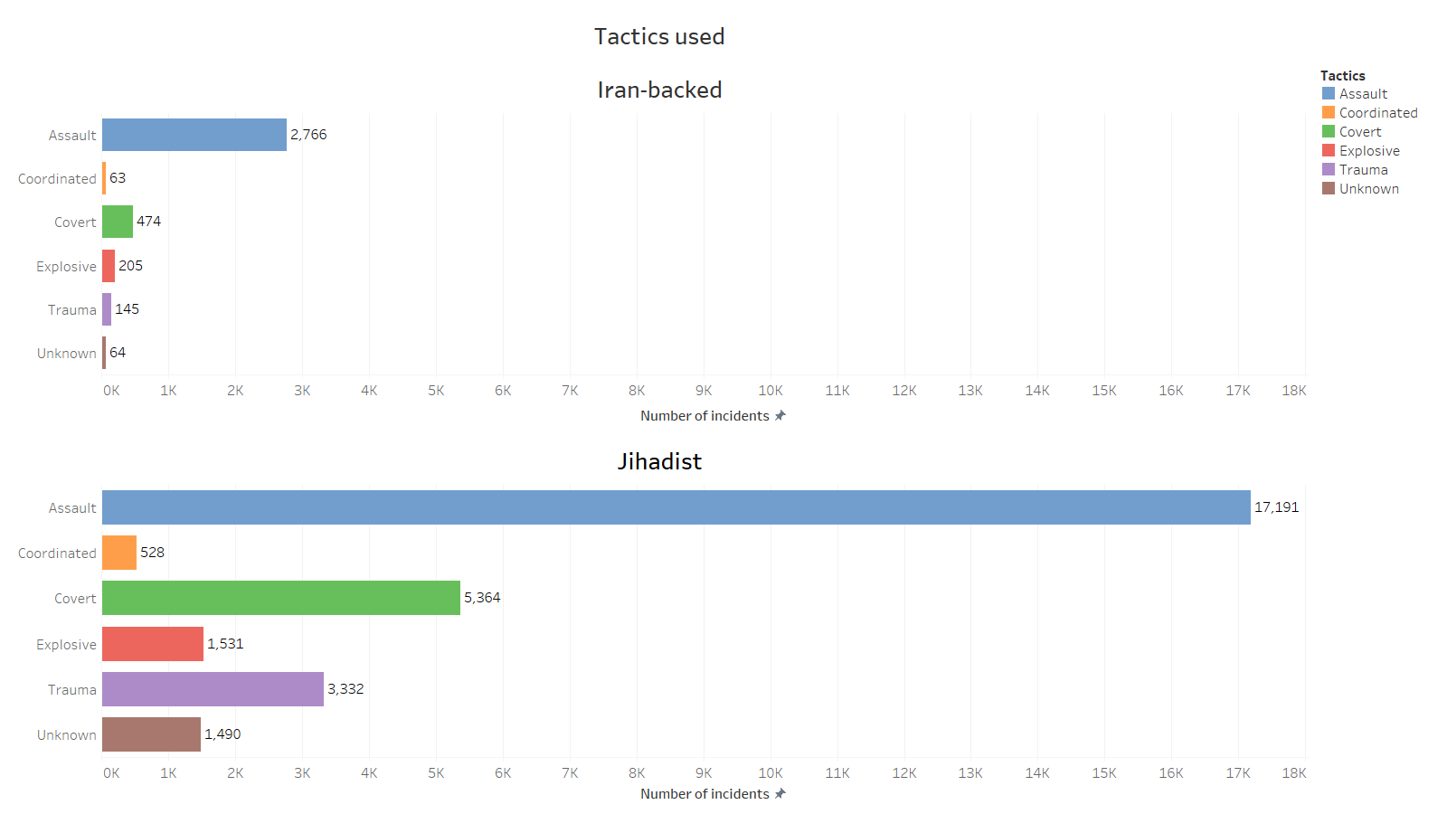

Slide 21
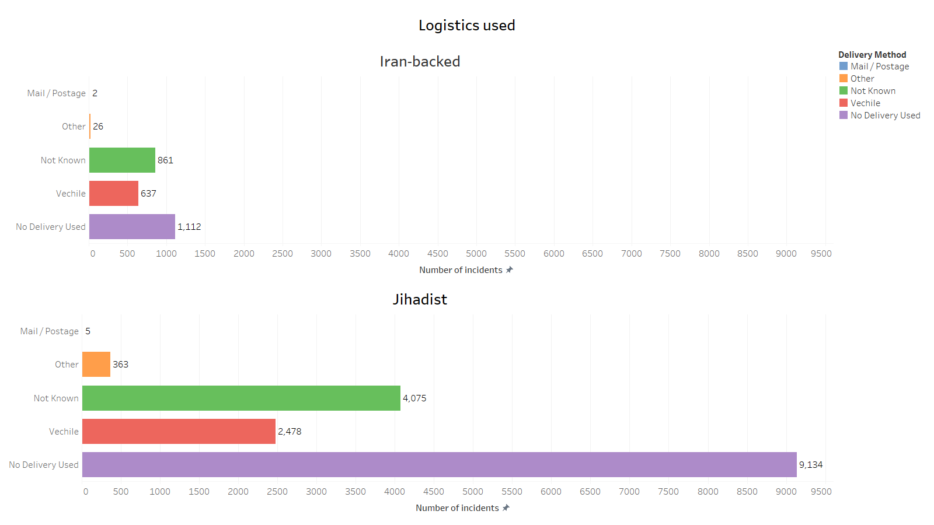

Slide 22
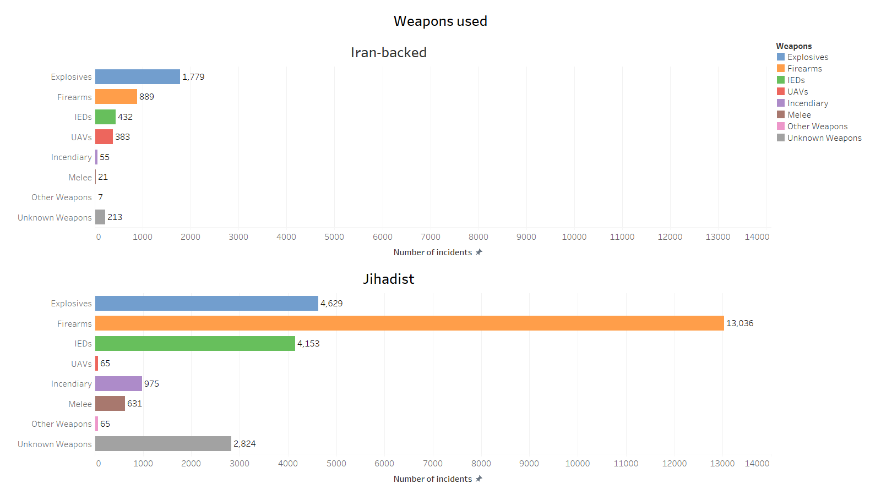

Slide 23
Research Question 5
What tactics, weapon types, and victim types have Lone actors, Jihadists, Right-Wing Extremists and Vigilante (Pro-Government) used?

Slide 24
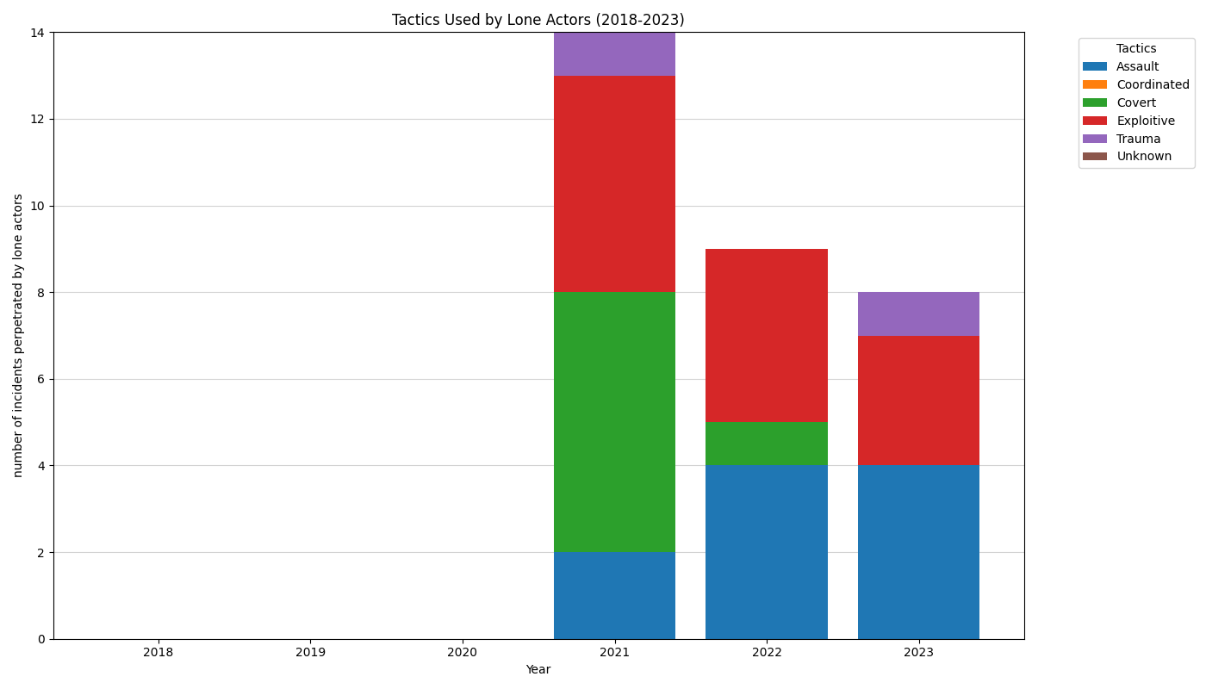

Slide 25
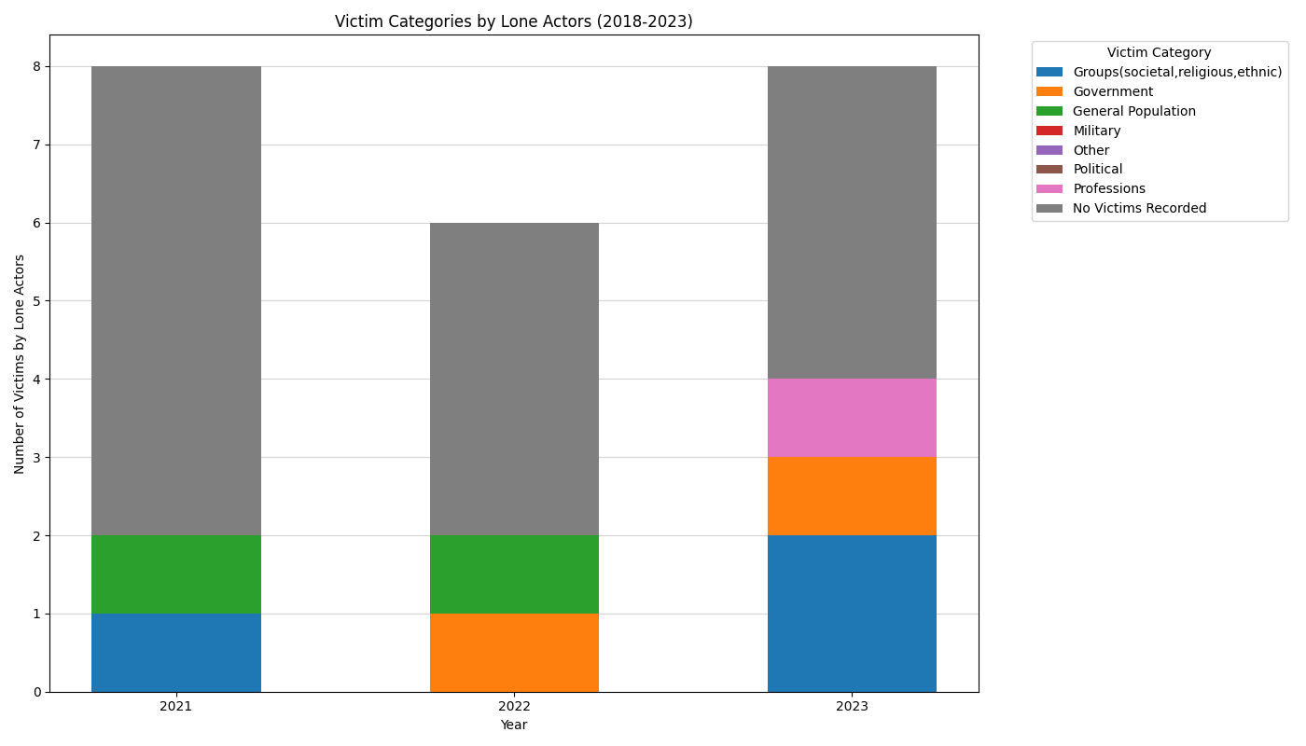

Slide 26
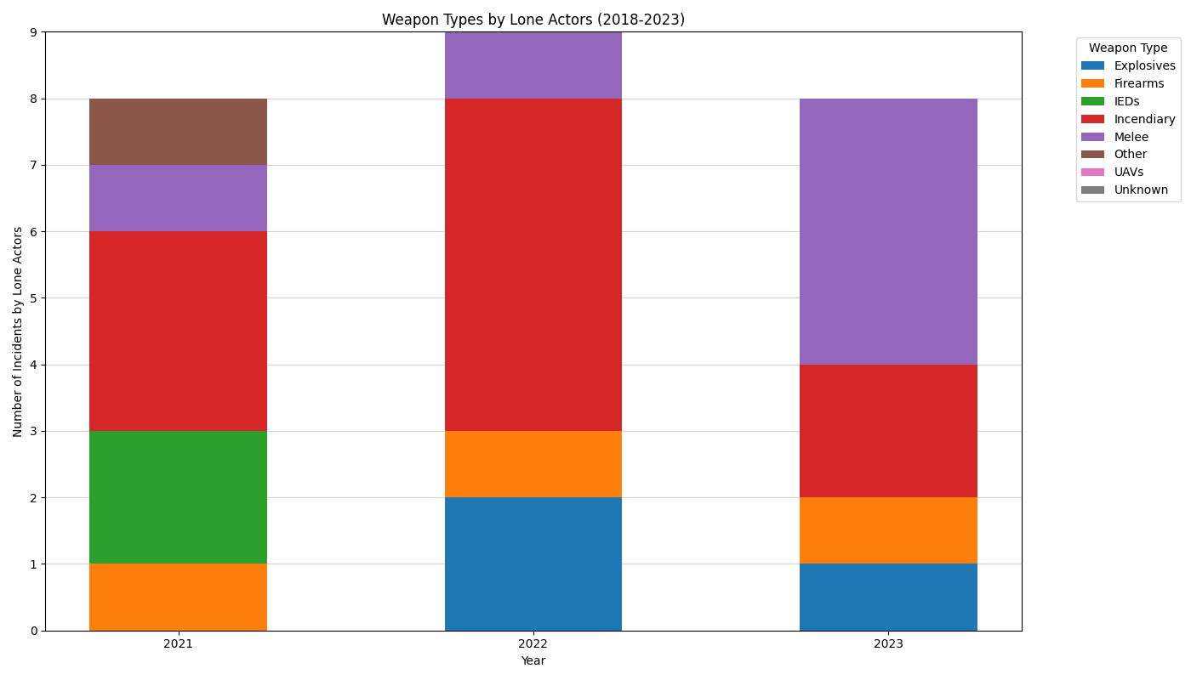

Slide 27
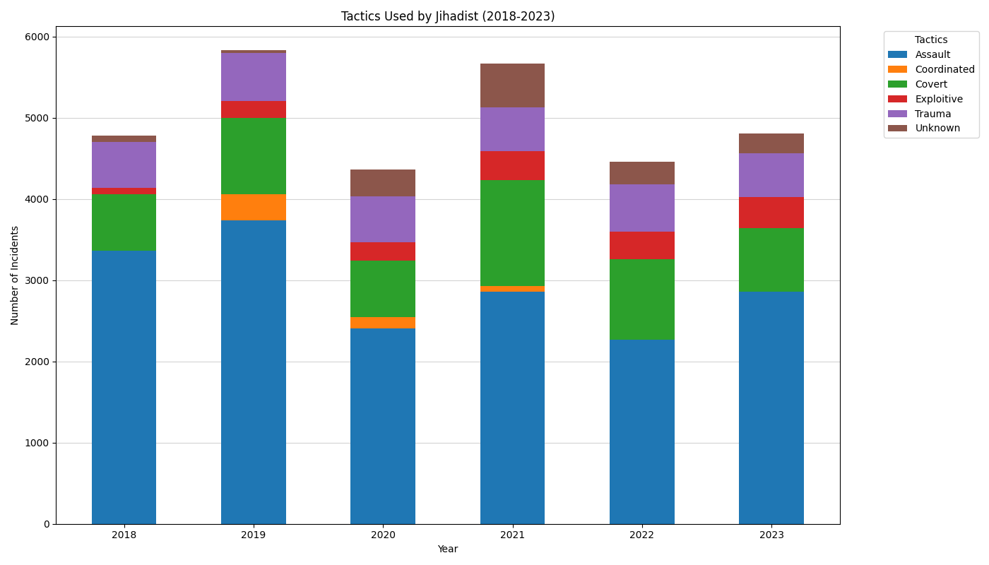

Slide 28
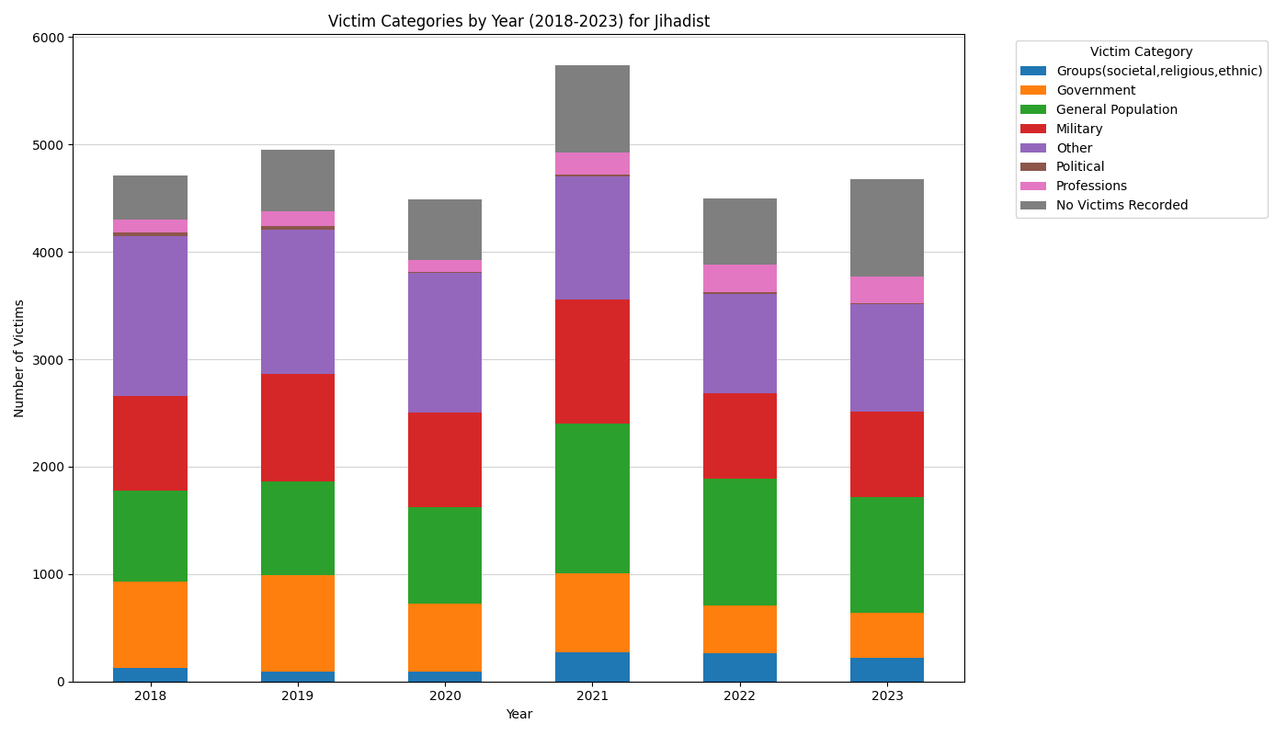

Slide 29
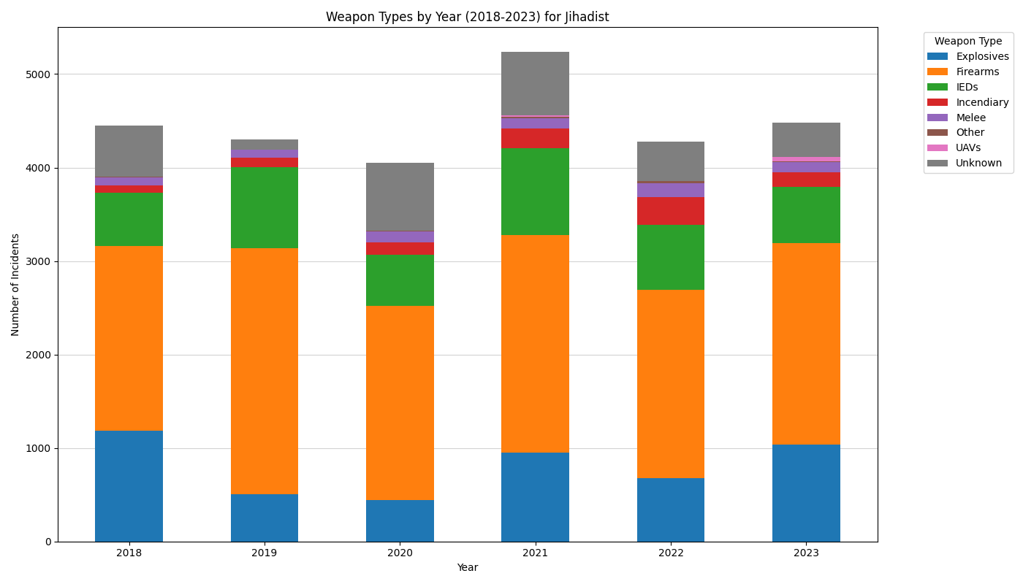

Slide 30
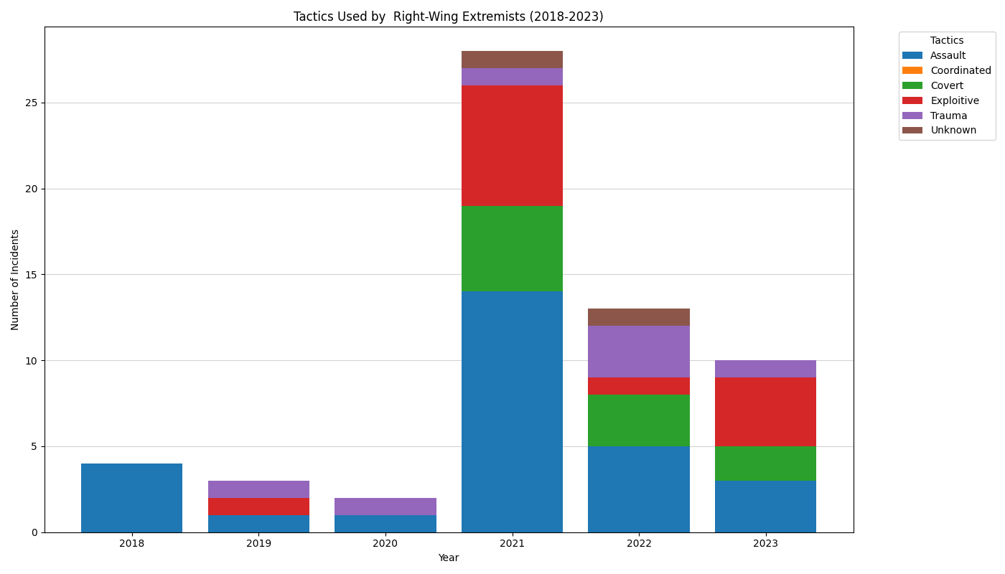

Slide 31
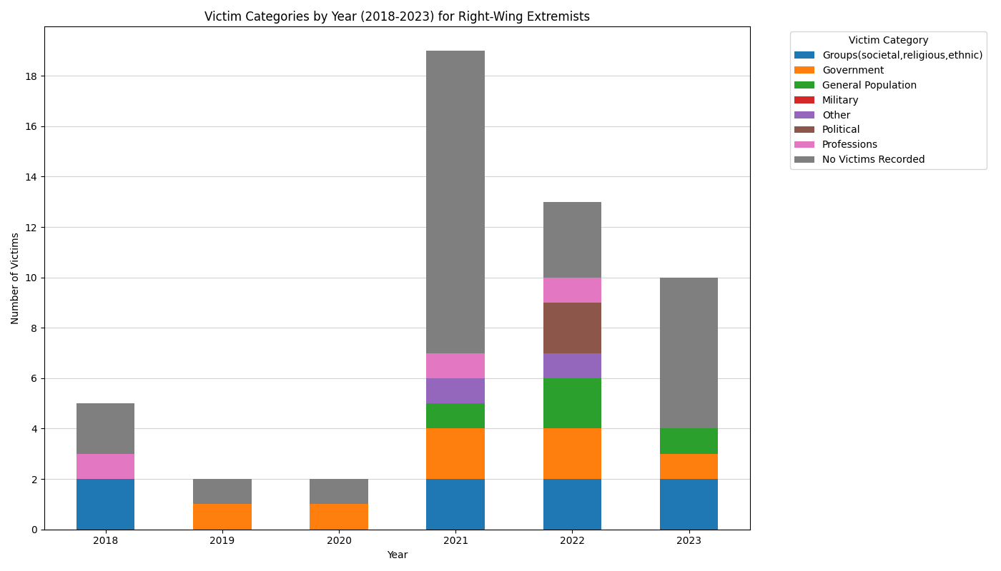

Slide 32
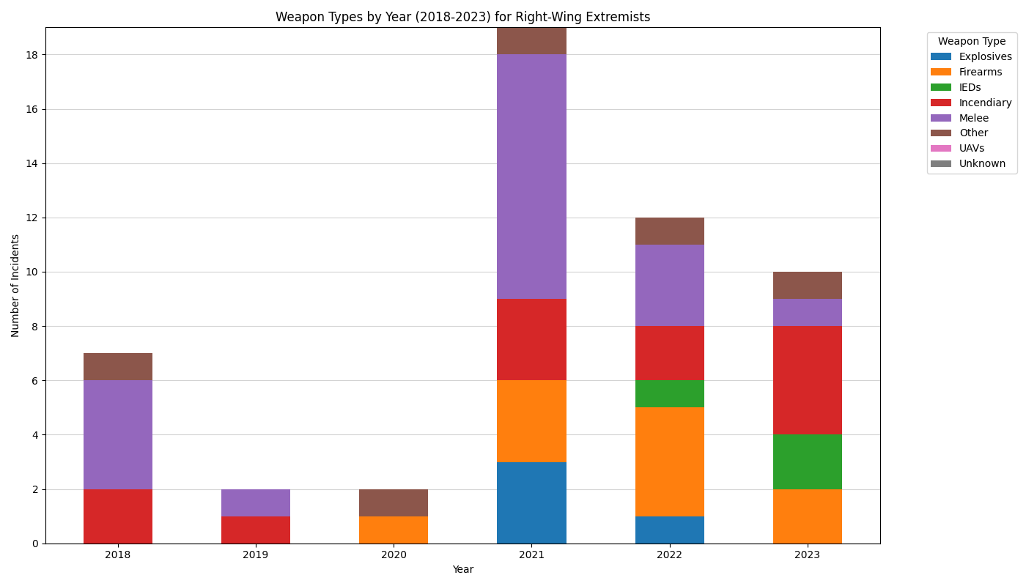

Slide 33
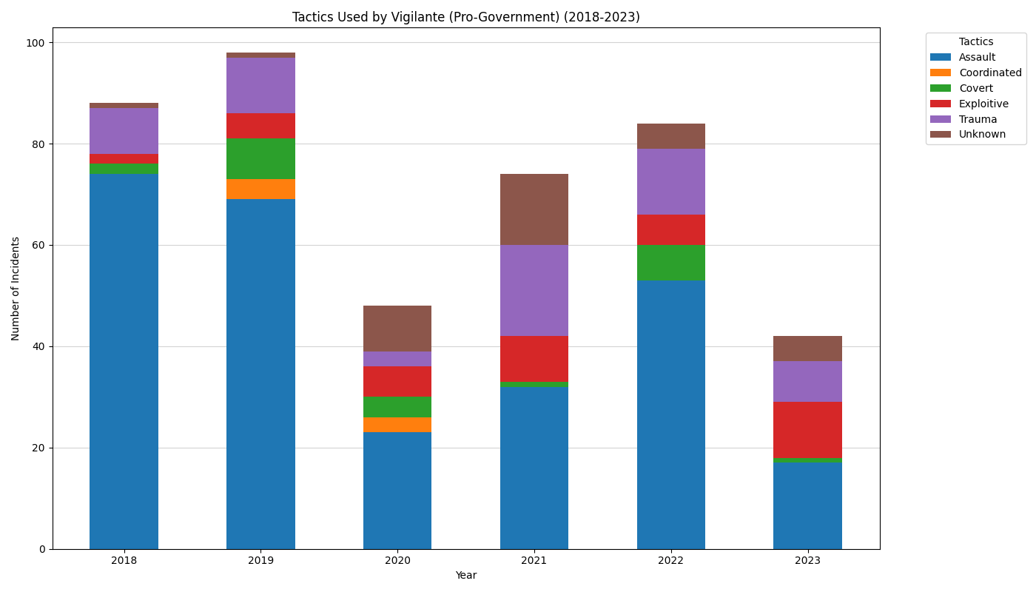

Slide 34
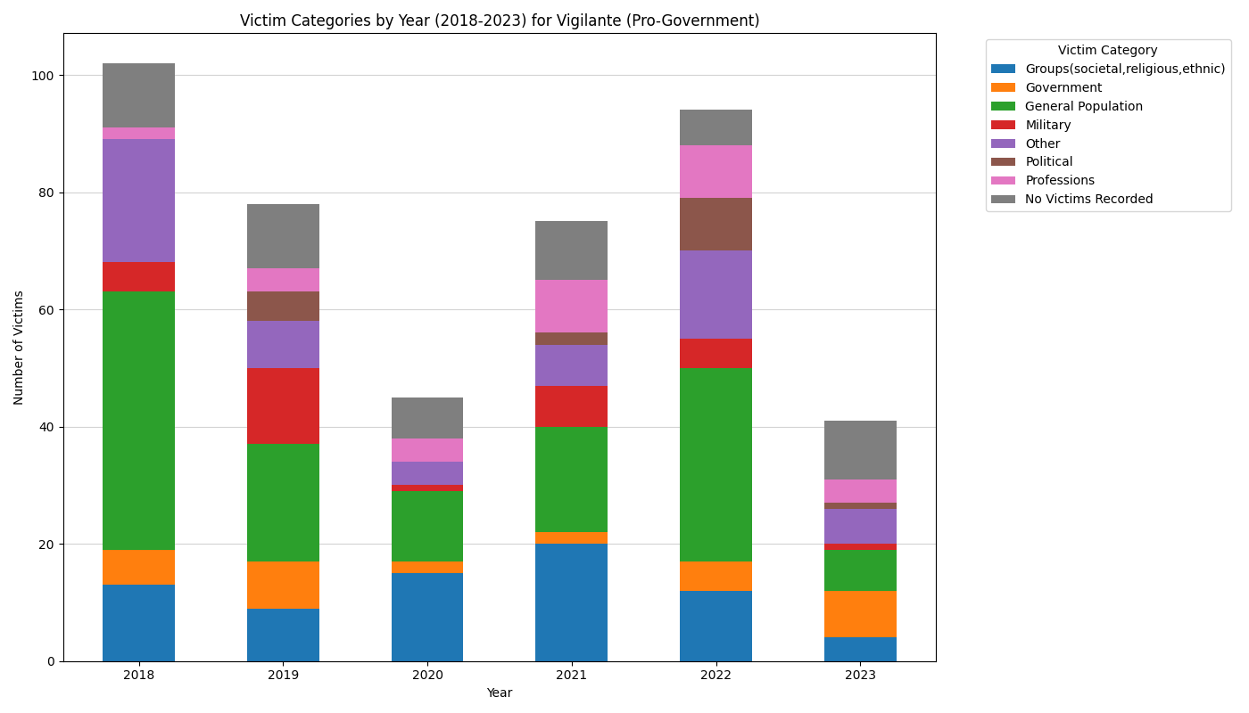

Slide 35
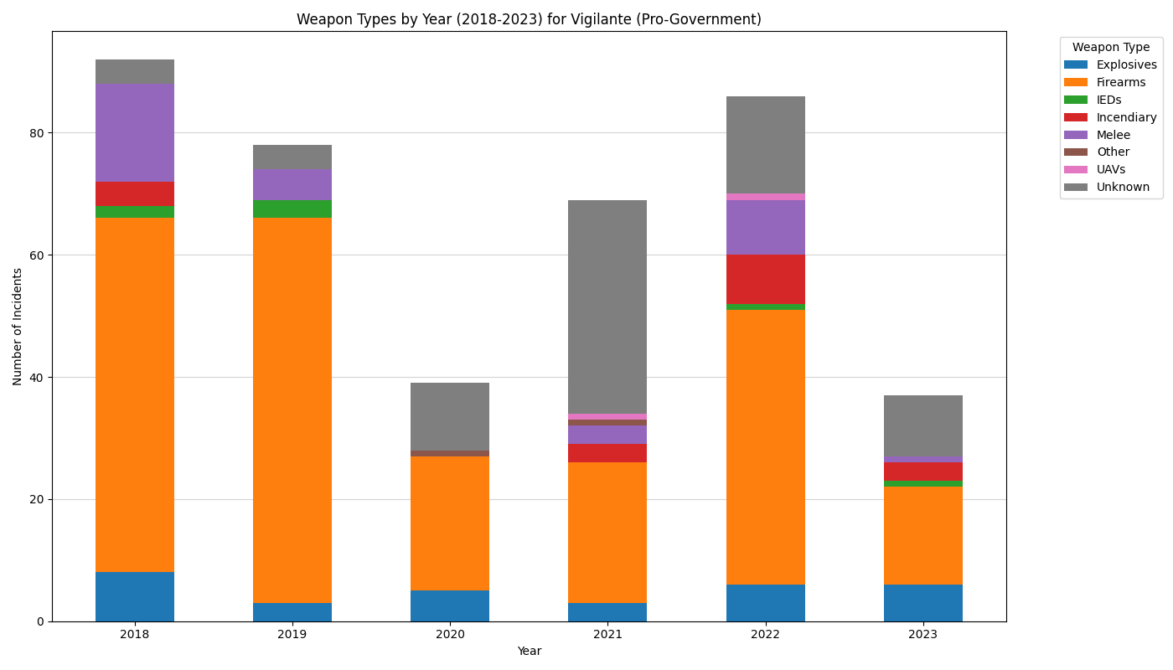

Slide 36
Research Question 6
Is there a positive correlation between the terrorist perpetrator types and the attack types?

Slide 37
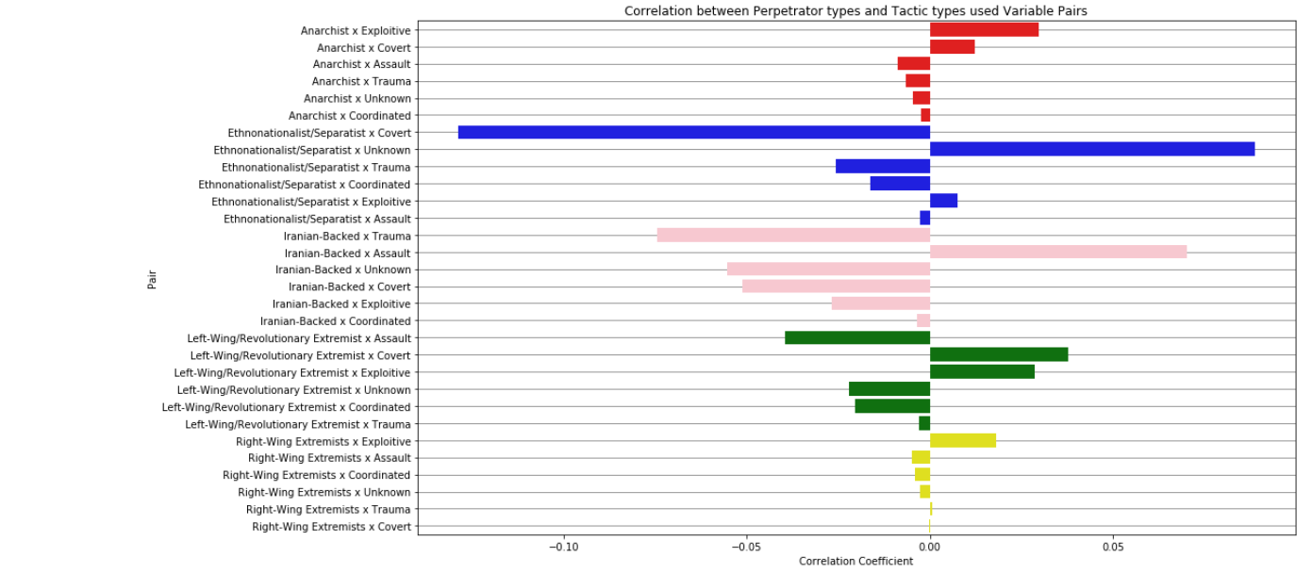

Slide 38
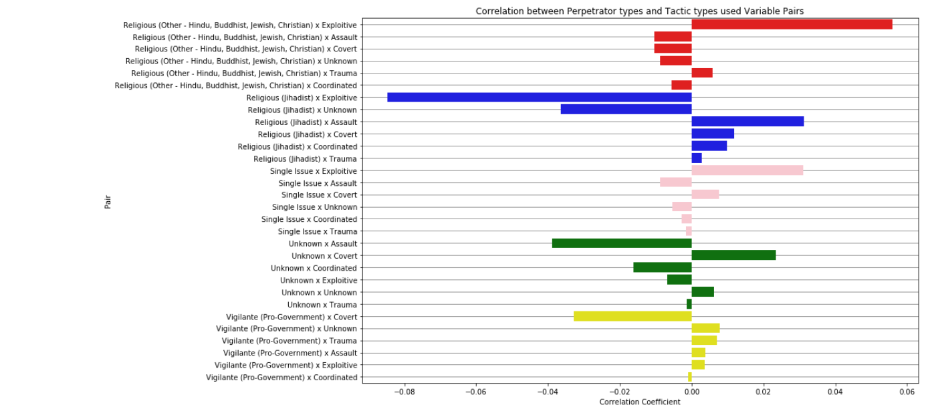

Slide 39
Research Question 7
What factors affect the severity of terrorist attacks? (severity is measured by the number of people killed in an incident)

Slide 40
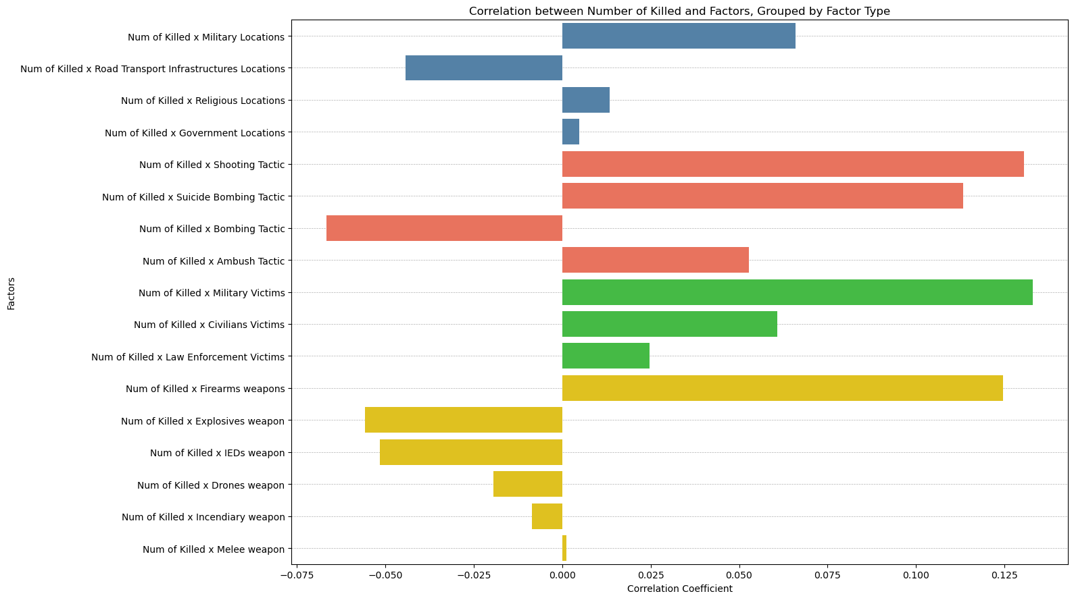

Slide 41
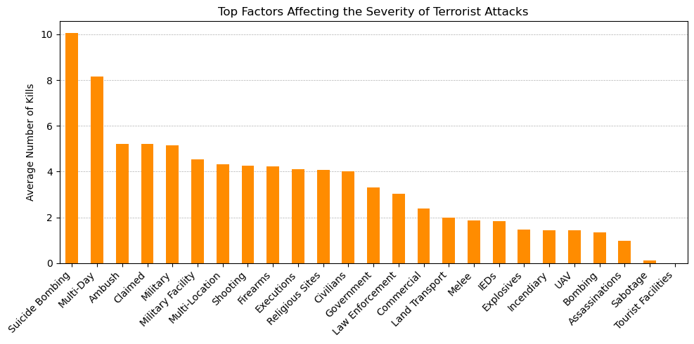

Slide 42
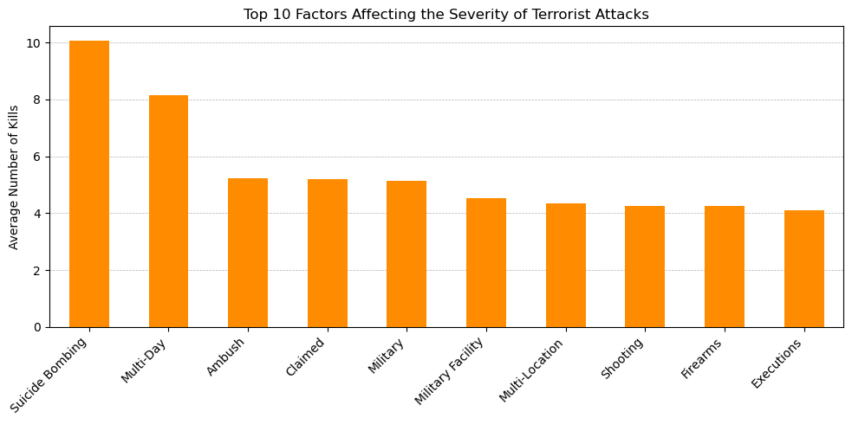

Slide 43
Research Question 8
Do weapon and target types impact the tactic type of a terrorist organization?

Slide 44
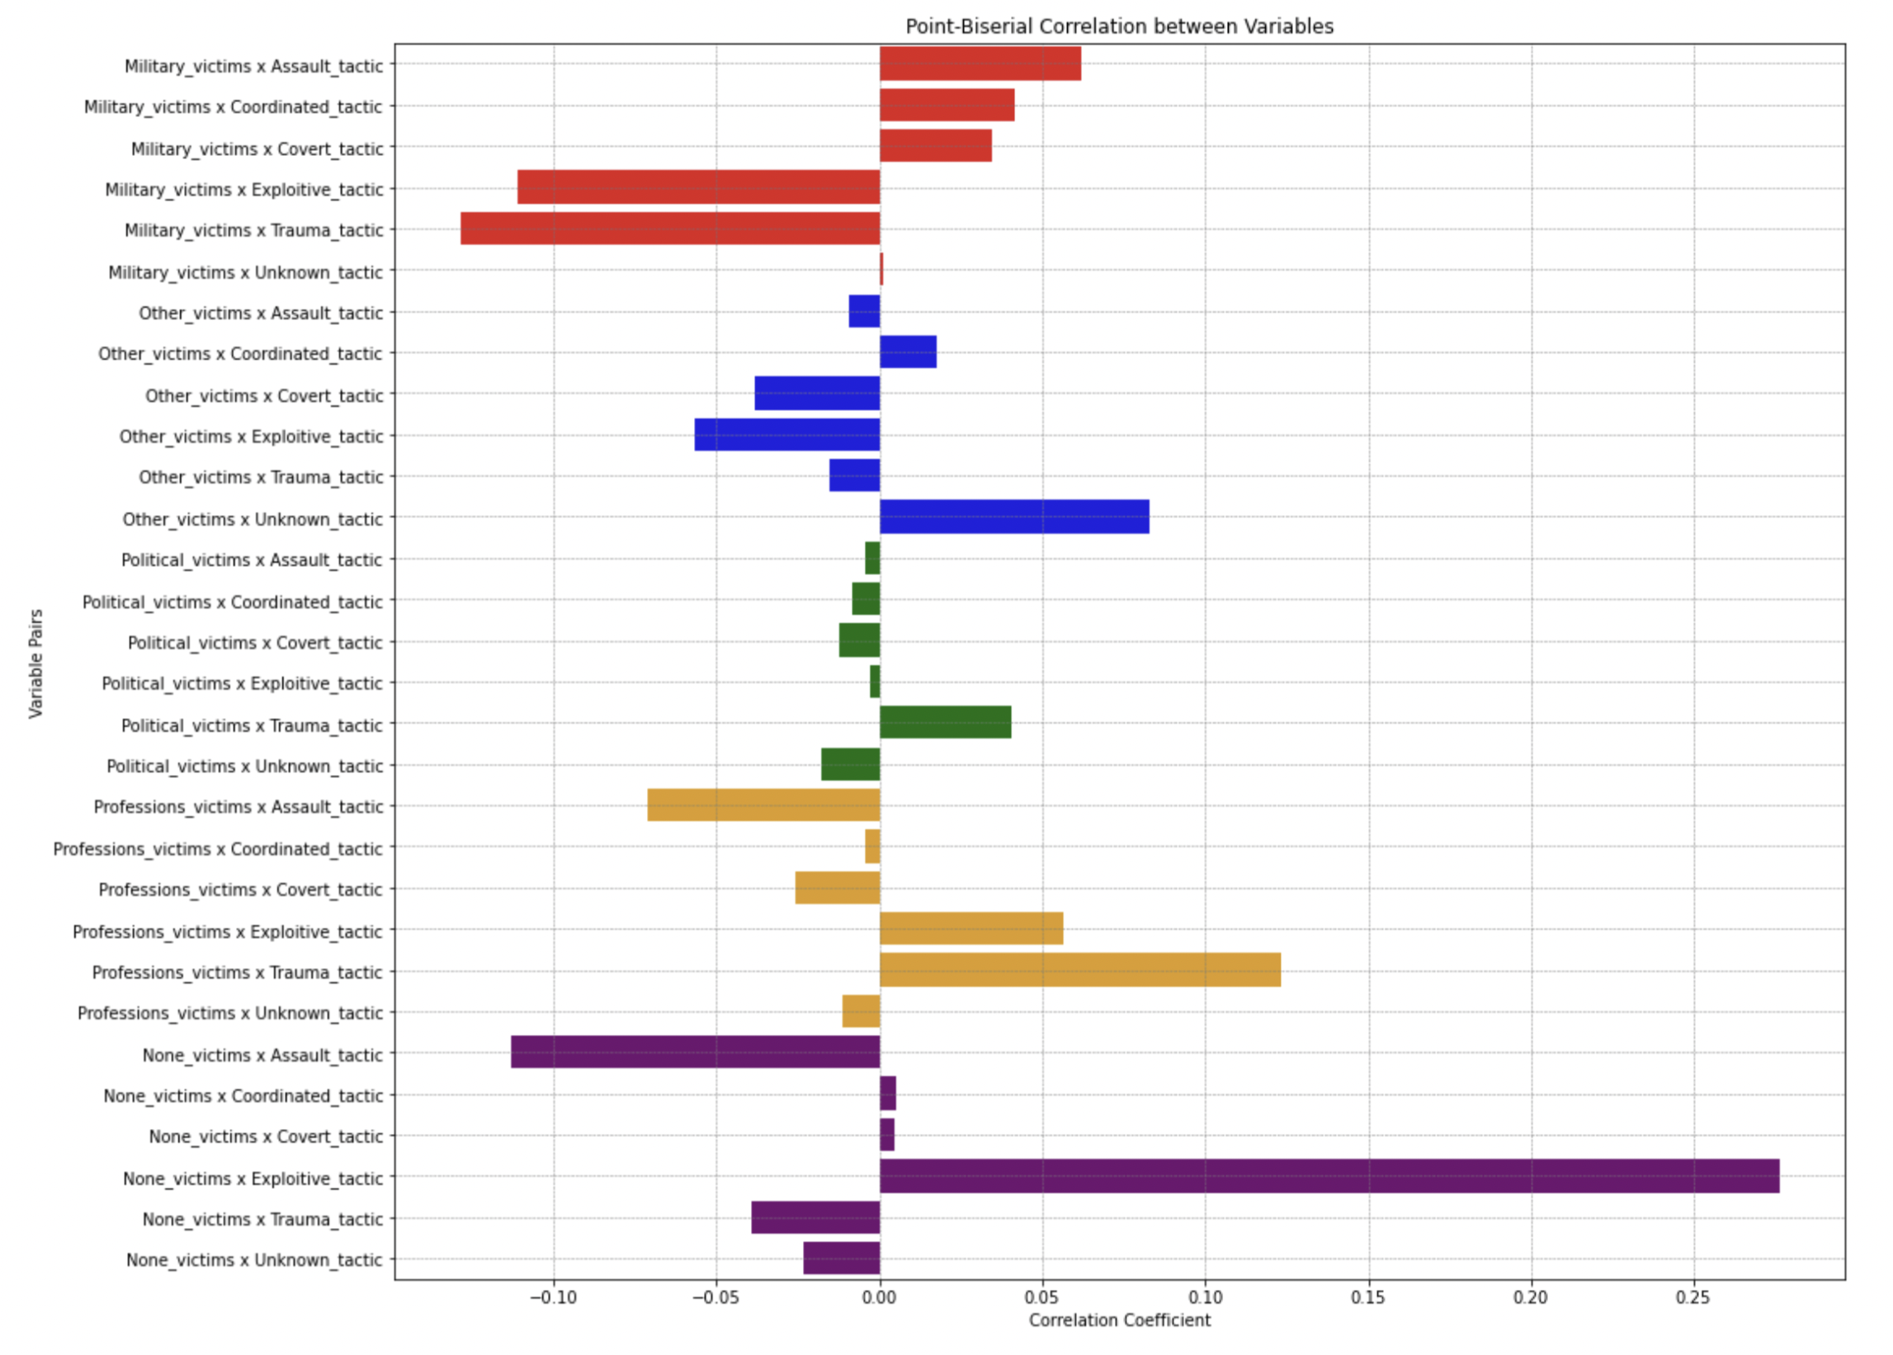

Slide 45
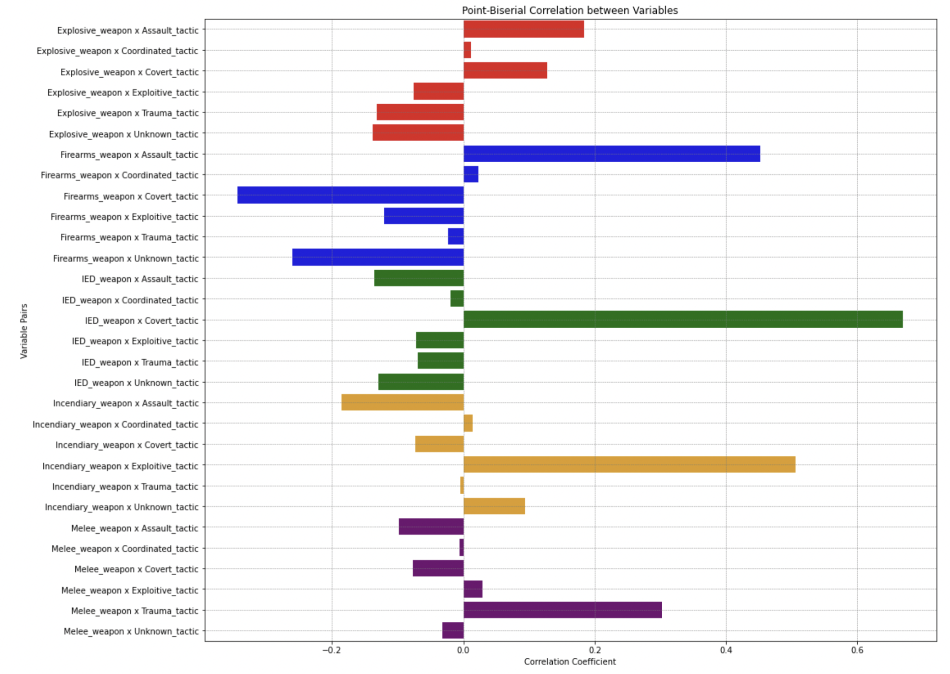

Slide 46
Dashboard
Tableau

Slide 47


Slide 48
Summary
Offered critical data-driven insights that aid in understanding effective terrorism strategies globally, contributing to a more informed and proactive counterterrorism posture.
The project supports information analysis of terrorism by highlighting trends and offering detailed analyses of terrorist operations and their implications.
Identified Afghanistan and Syria as key hotspots with the highest number of incidents.
Highlighted superior operational capacities of religious and ethnonationalist/separatist groups, resulting in greater casualties and more extensive damage.
Analyzed the dynamic shifts in terrorist tactics, targets, weapons, and logistics, revealing a trend towards greater sophistication and diversity in attack methodologies.
Developed a General Terrorism Dashboard, enhancing the capability to visualize complex data in real-time, thereby supporting in analysis of terrorism trends.

Slide 49
Next Steps
Cloud Migration Dashboard
Multilingual Dashboard
User Pattern Analysis
User Feedback Implementation
Predictive Analytics.

Slide 50

Questions ?

Slide 51
Thank You

